Slide 1
The Office of Curriculum Systems
Fiona Liken, Associate Vice President for Instruction and Registrar
Brooke Daniel, Assistant Director of Curriculum Systems
The University of Georgia Office of the Vice President for Instruction

Slide 2
The Office of Curriculum Systems
Serves as the university-wide resource for academic policies and procedures
Management of the curriculum approval process university-wide
Management of the course approval process (CAPA) and syllabus update system
Production of the online Bulletin (course catalog)
Development of a complete undergraduate degree database and approval process
The University of Georgia Office of the Vice President for Instruction

Slide 3
The Office of Curriculum Systems
Supports and facilitates university faculty governance
University Curriculum Committee (UCC)
Subcommittees:
General Education
Cultural Diversity
Environmental Awareness
Experiential Learning
The University of Georgia Office of the Vice President for Instruction

Slide 4
The Office of Curriculum Systems
Manages the First-Year Odyssey Seminar Program
Over 35,000 students enrolled in FYOS 1001 since fall 2011
Over 300 different seminar topics offered each fall semester and over 50 different seminar topics each spring semester
Faculty from all 16 schools and colleges have taught an FYO seminar
Over 75 different departments have faculty teaching FYO seminars
www.fyo.uga.edu
The University of Georgia Office of the Vice President for Instruction

Slide 5
The Office of Curriculum Systems
Supports the Study Abroad Reapproval Process
Review academic information in study abroad programs
Ensure compliance with UGA, Board of Regents, and SACS policies
Developed an online course approval system to facilitate study abroad course review by department heads and deans
The University of Georgia Office of the Vice President for Instruction

Slide 6
Online Bulletin
Official UGA resource for majors, courses, and academic information
Online course catalog for all approved UGA courses
Courses and syllabus information
Undergraduate major, minor, and certificate requirements
Academic policies and procedures
Two versions of the Bulletin each year – fall and spring
Over 1000 changes to the Bulletin each year
https://www.bulletin.uga.edu
The University of Georgia Office of the Vice President for Instruction

Slide 7
Procedure for Routing of Degree Requirement Changes
Print out copy of degree requirements from the online Bulletin
Make changes on printed copy. Extensive changes or information on new programs should be sent as an email attachment in MS Word to currsys@uga.edu
Obtain department head and dean's approval and signatures
Forward to the Office of Curriculum Systems, 319 New College
Office of Curriculum Systems will review and consider revisions
Approved revisions to degree requirements will be added to the Bulletin and forwarded to the office of the Registrar for inclusion in the DegreeWorks system
Deadlines for Bulletin changes are posted online at bulletin.uga.edu
The University of Georgia Office of the Vice President for Instruction

Slide 8
Program Approval Process
Approval process for:
New Majors, Minors, Certificates
New Departments, Schools/Colleges, Institutes, Centers
New Areas of Emphasis
Name Changes
Terminations and Deactivations
University-wide Requirements
Entrance Requirements and High-Demand Selection Criteria
Substantive Change to Programs
Academic Policies
University Curriculum Committee considers 60+ proposals each year
The University of Georgia Office of the Vice President for Instruction

Slide 9
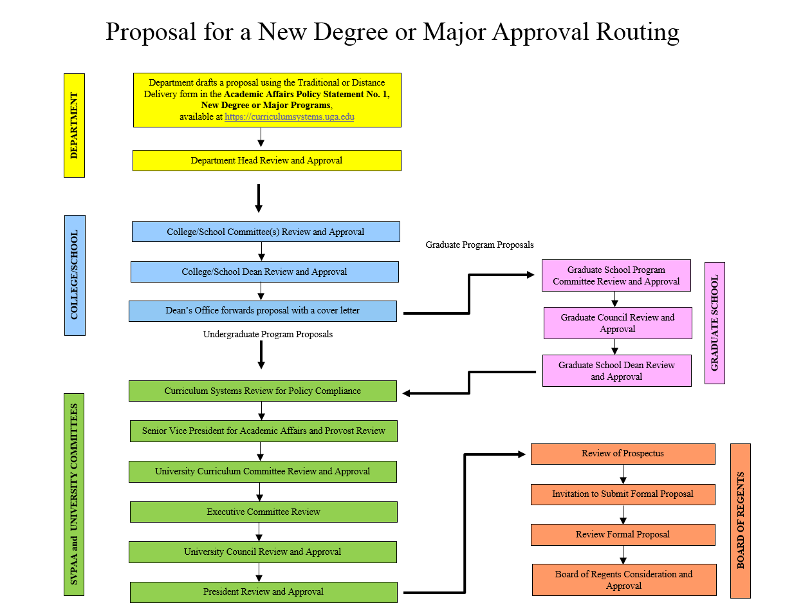
The University of Georgia Office of the Vice President for Instruction

Slide 10
Online Course Approval System (CAPA)
Online course approval process
Online voting by department heads, deans, and committee members
Over 350 new courses approved each year
Over 800 course changes approved each year
Includes browse feature to view status of courses in approval process
https://www.capa.uga.edu/
The University of Georgia Office of the Vice President for Instruction

Slide 11
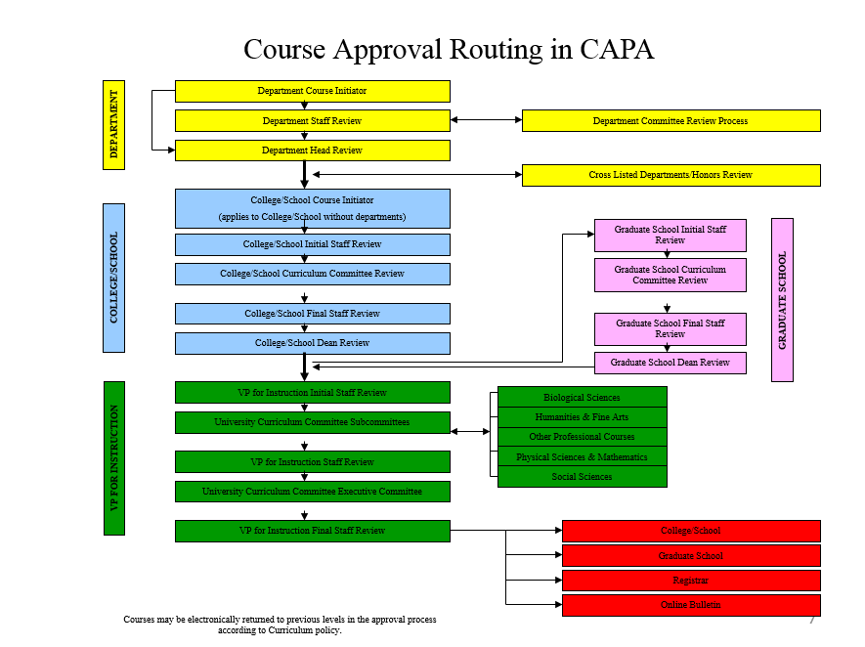
The University of Georgia Office of the Vice President for Instruction

Slide 12
For more information about…
Academic Policies and Procedures
Bulletin
CAPA (Course Approval Process Automation)
Courses
Departments, Schools, Colleges, Centers, and Institutes
Double Dawgs
Experiential Learning
Field Study
Final Examination Schedule Conflicts
First-Year Odyssey Seminar Program
General Education Core Curriculum
Lab/Supply Fees
Majors, Minors, Certificates
Study Abroad Course Approval
Transfer Information
UGA Study Abroad Programs
University Curriculum Committee and Subcommittees
University-Wide Degree Requirements
… go to www.curriculumsystems.uga.edu
The University of Georgia Office of the Vice President for Instruction

Slide 13
Questions?
Office of Curriculum Systems
Website: www.curriculumsystems.uga.edu
Phone: 706-542-6358
Email: currsys@uga.edu
UGA Online Bulletin
Website: www.bulletin.uga.edu
Email: bulletin@uga.edu
Online Course Approval (CAPA)
Website: www.capa.uga.edu
Email: capa@uga.edu
First-Year Odyssey Seminar Program
Website: www.fyo.uga.edu
Email: fyo@uga.edu
Online Syllabus System
Website: www.syllabus.uga.edu
Email: currsys@uga.edu
Double Dawgs
Website: www.doubledawgs.uga.edu
Email: doubledawgs@uga.edu
Study Abroad - Academic
Website:
www.syllabus.uga.edu/StudyAbroad_Login.aspx
Email: csabroad@uga.edu
The University of Georgia Office of the Vice President for Instruction

